Slide 1
Sudoku
In React Native
Michael Rooplall

Slide 2
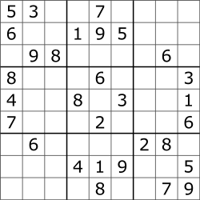
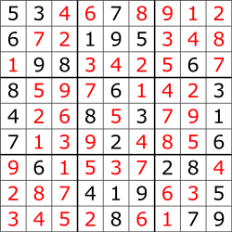
What is Sudoku
Sudoku is a logic based number-placement puzzle.
The objective is to fill a 9x9 grid with digits, so that each column, each row, and each 3x3 subgrid (or “block”) contain all the digits from 1 to 9, with no repetitions.
The puzzle begins partially completed depending on the difficulty, and it is up to the user to fill it in.
An example of a sudoku puzzle, and it’s solution

Slide 3
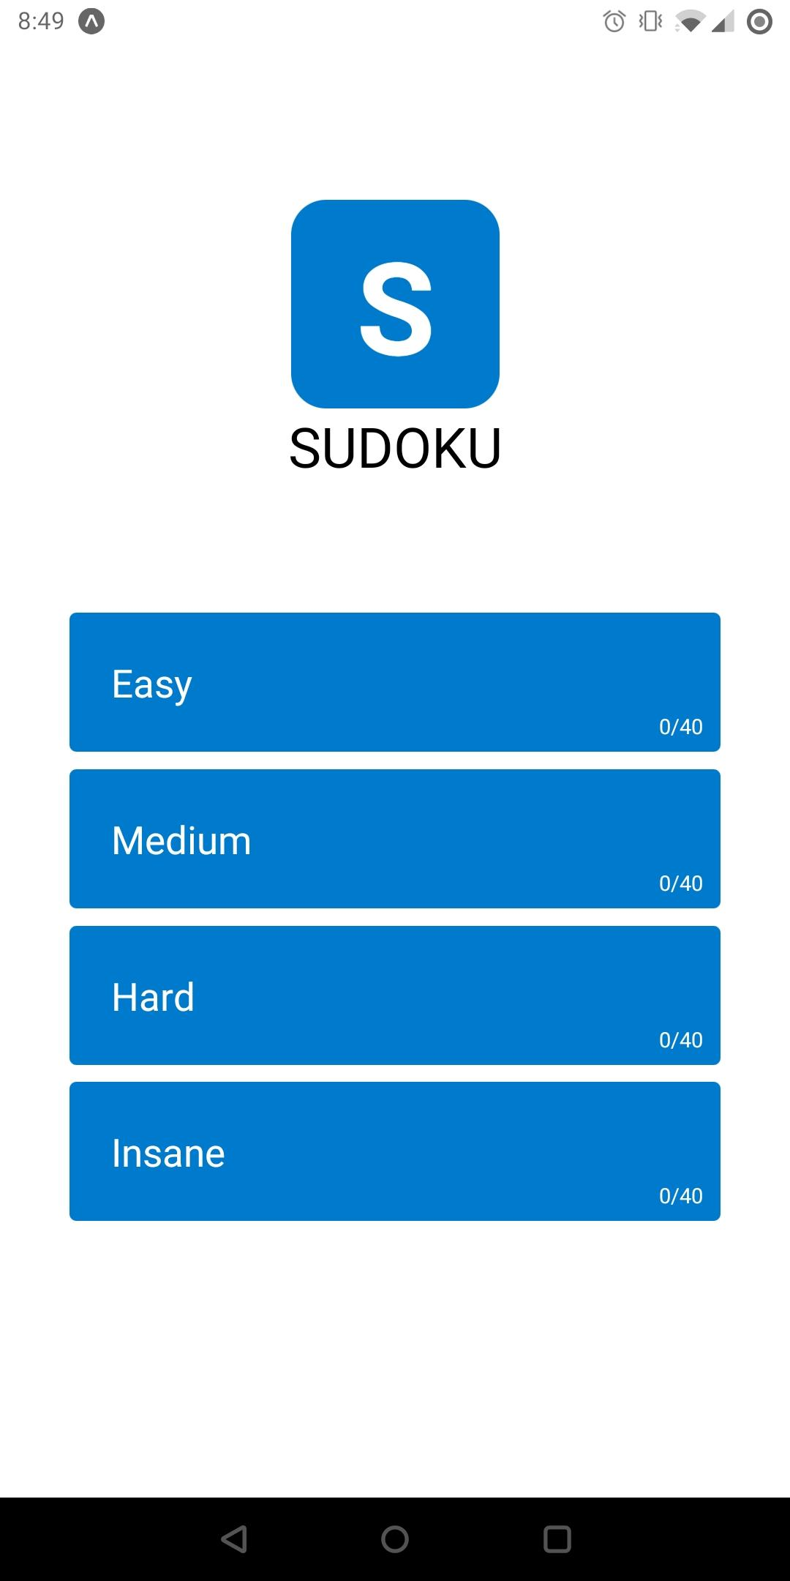
Home Screen
The Home screen shows the different difficulties available to play.
The number of levels a player has completed are also tracked.
A Flatlist component allowed me to dynamically create buttons from an array.

Slide 4
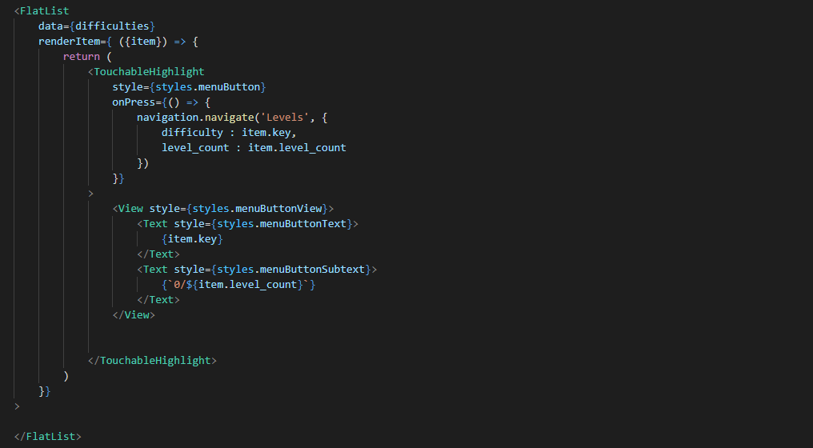
Passing an array of objects similar to [ {key : “Easy”, level_count : 40}, {key : “Medium”, level_count : 40}, {key : “Hard”, level_count : 40}, {key : “Insane”, level_count : 40} ] was used to generate the home screen using FlatList

Slide 5
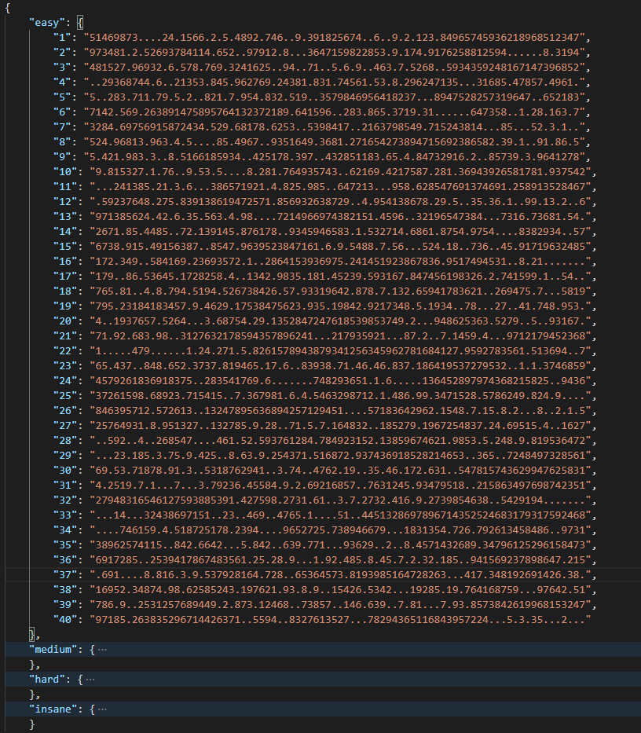
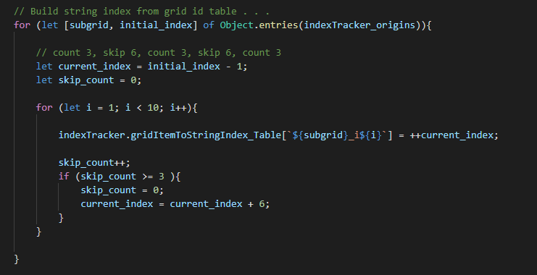
I precompiled 40 levels for each difficulty and stored them in a local JSON file
Each string represents a valid unsolved sudoku puzzle.
This string is later formatted to match the traditional grid layout

Slide 6
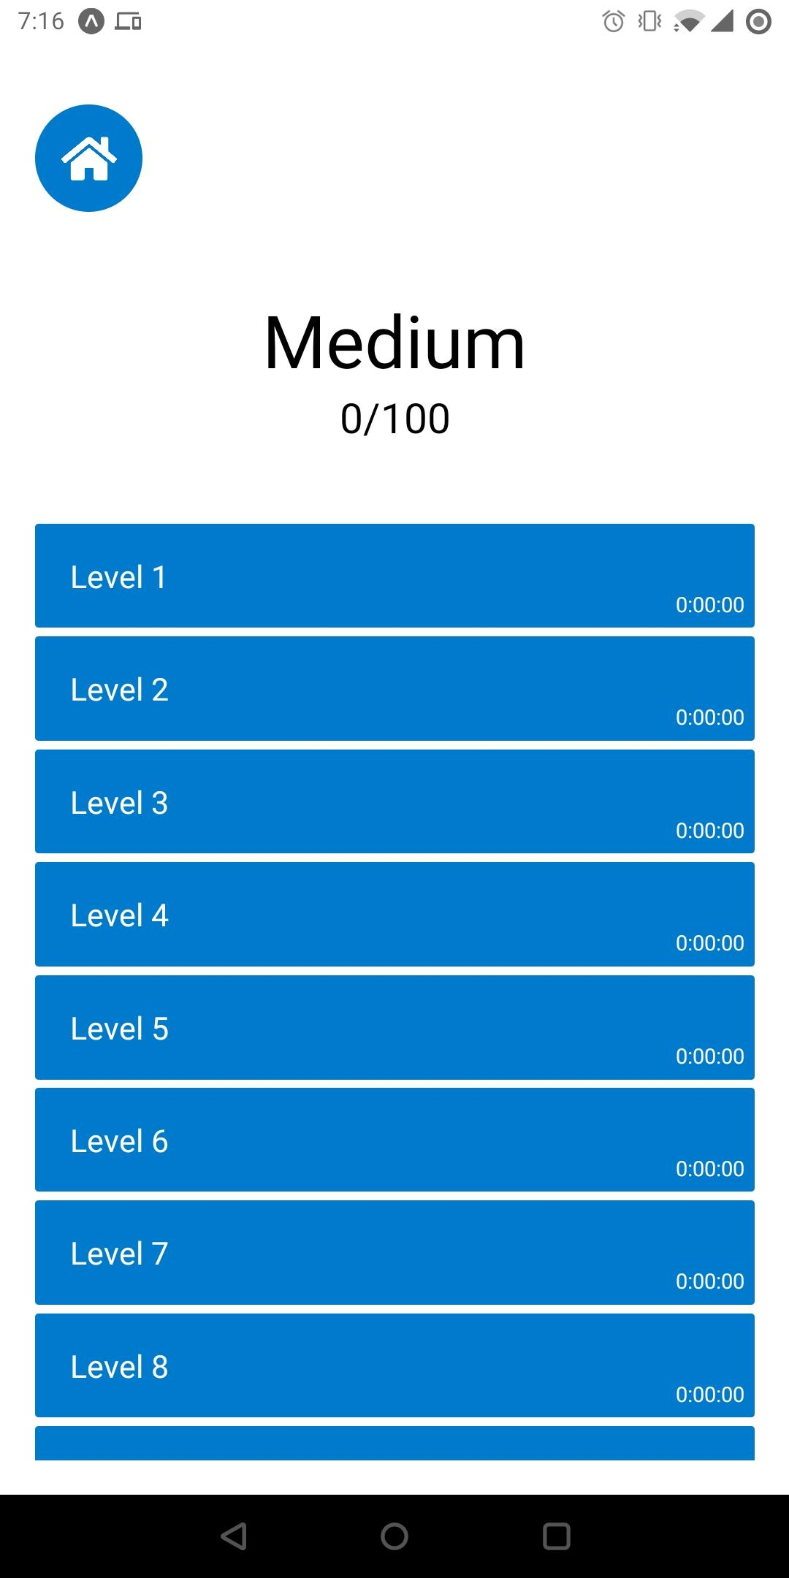
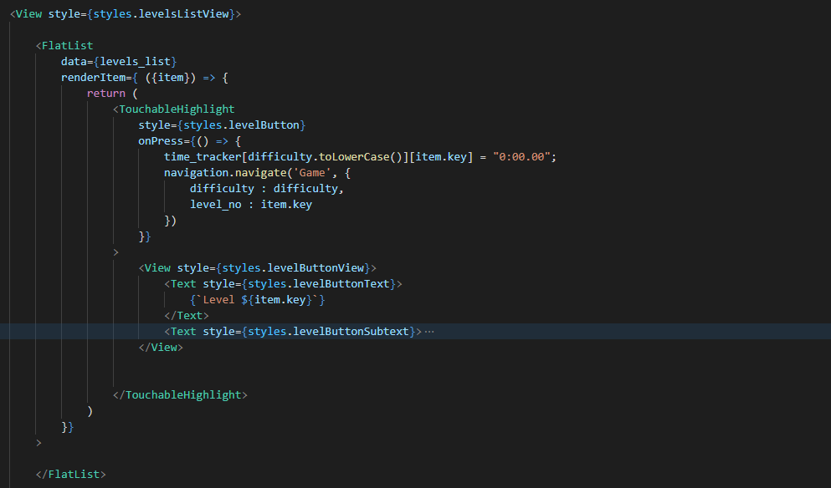
Level Selector
The number of levels for each difficulty are loaded from the JSON file, and also rendered dynamically using FlatList.

Slide 7
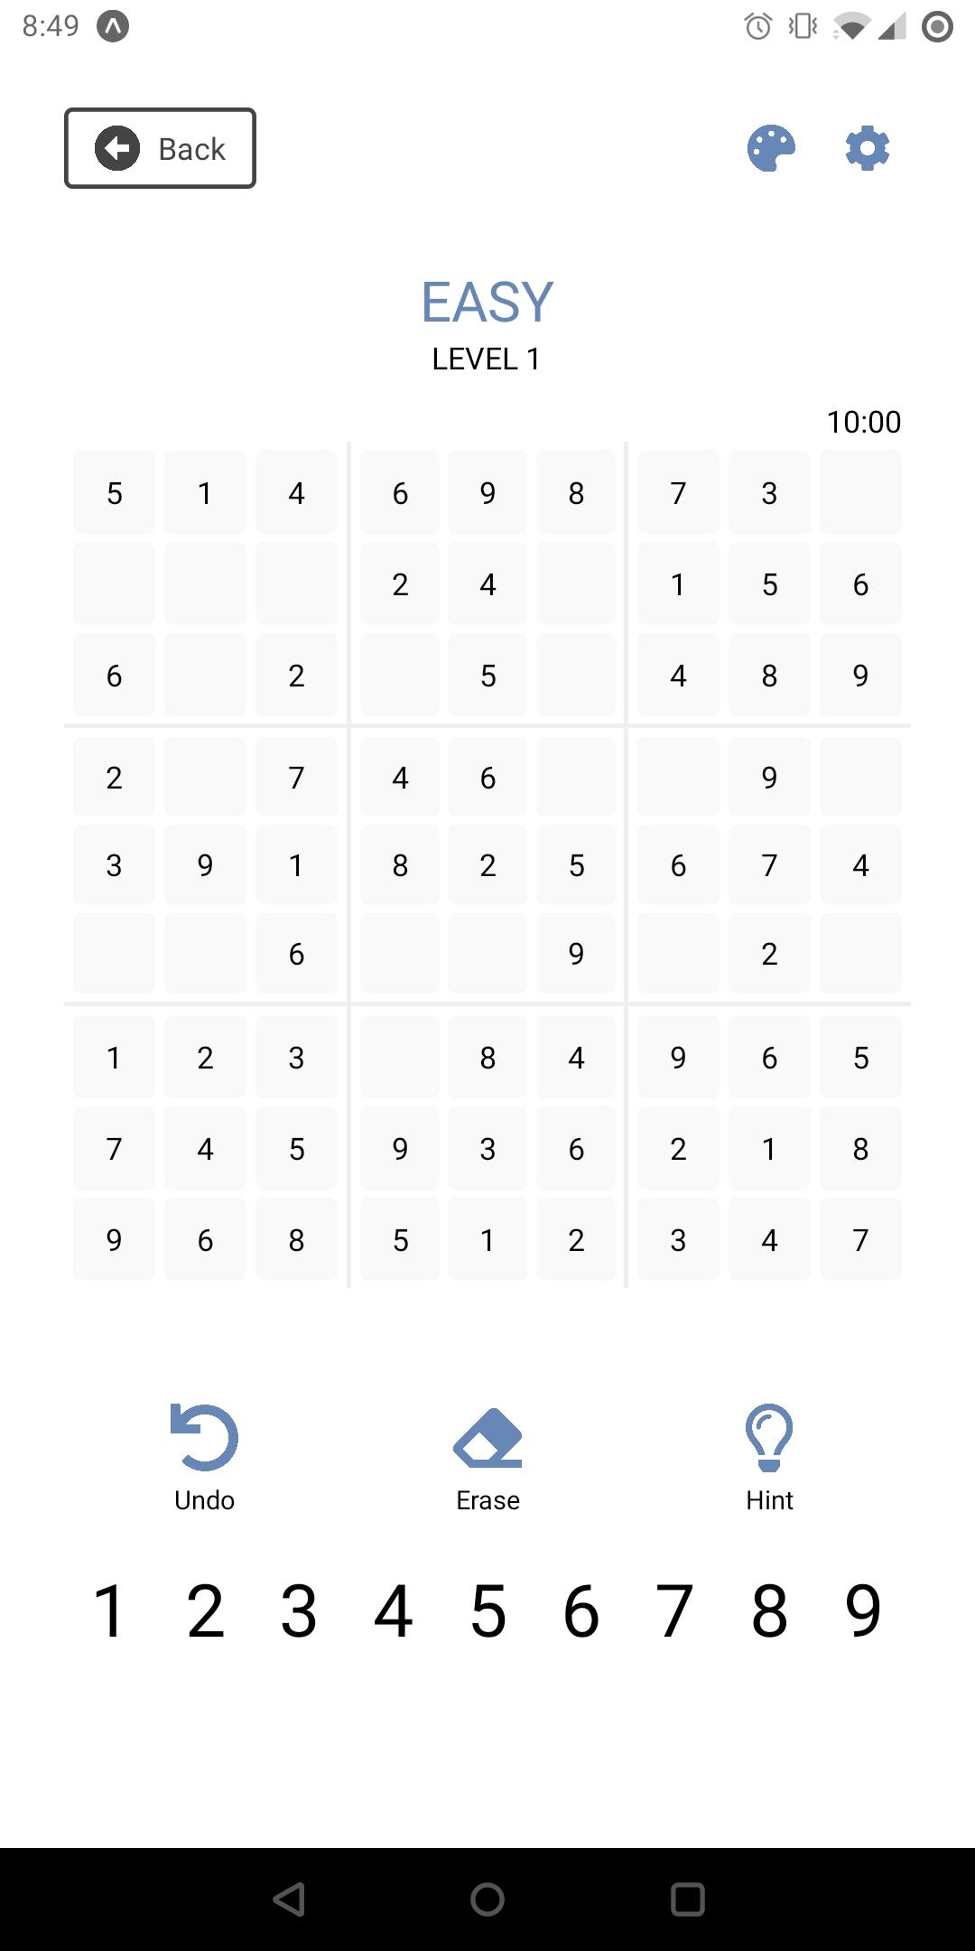
Game Page
The game page contained a top bar of buttons, the game grid, a row of image buttons, and of the number buttons.
The state of the difficulty and level number are remembered from the previous pages.
There is also a non-functional timer to track the player’s progress

Slide 8
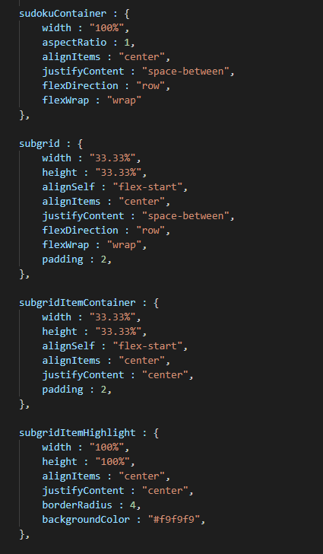
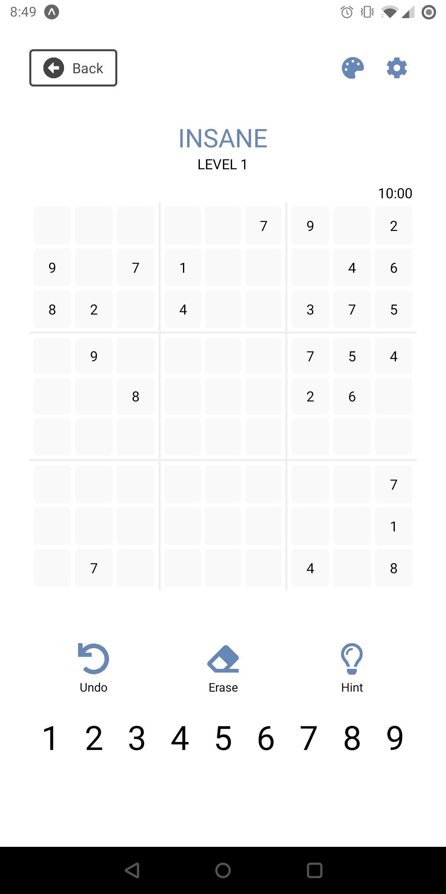
The game grid itself is very complex.
Each section was split off into 9 subgrid components. Each subgrid then contained 9 “item” cells.
Using percentage widths and heights and a combination of flex layouts and aligning, I was able to get a nicely centered grid.

Slide 9

Demo Video

Slide 10
Challenges
The game grid view was tough to implement as React Native does not have a simple Grid View like CSS on the web.
Because the sudoku games are 81 character long strings reading from left to right, I had write code to map each string index to their respective subgrid and cell.
React Native also does not support SVG images out of the box. I had to convert the icons to PNGs and recolor them manually.

Slide 11
Future Work
The ability to change “themes” (eg. colors, borders, fonts, etc.) would be an upcoming feature I look forward to adding.
Add functionality to the timer, so you can see how long it took to complete a puzzle.
Implementation of a “Random Challenge” to generate new random puzzles, if the player wants more than the pre-generated puzzles included.

Slide 12
fin
GitHub: https://github.com/DeveloperBlue/SudokuReactNative

